Slide 1
PPOL 628: Text as Data – Computational Linguistics for Social Scientists
Class 12: Word Embeddings

Slide 2
Today
Lecture: Word Embeddings.
Introduction to word embeddings.
Fitting Word2Vec.
Potential social science applications.
Lab: topic_models_2.R
Website: github.com/matthewjdenny/PPOL_628_Text_As_Data

Slide 3
Word Embeddings
Humans have learned understand words as connected to meanings, and are able to think of synonyms, make analogies, etc.
In order for computers to mimic this type of behavior, we have to represent words in a way that computers can “understand”.
One approach is to represent them as points in a (50-1000 dimensional) vector space. Meaning of words mapped to dimensions of vector space.
Turns out this approach works well in lots of NLP tasks – social science is still searching for a homerun application.
Many papers + tutorials (which I screenshot from liberally in these slides):
Visualization: http://jalammar.github.io/illustrated-word2vec/
Jurafsky Slides: https://web.stanford.edu/~jurafsky/slp3/slides/vector2.pdf
Tutorial: http://u.cs.biu.ac.il/~gonenhi/slides/WiDS_tutorial.pdf
GloVe Website: https://nlp.stanford.edu/projects/glove/

Slide 4
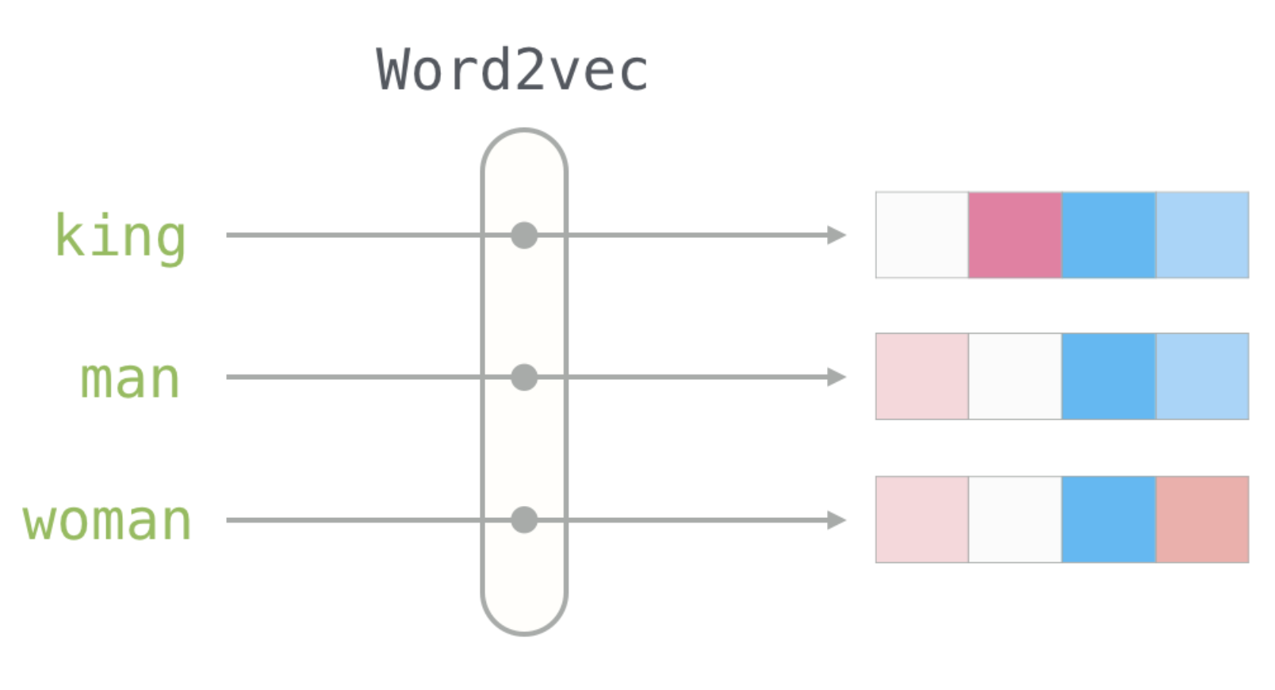
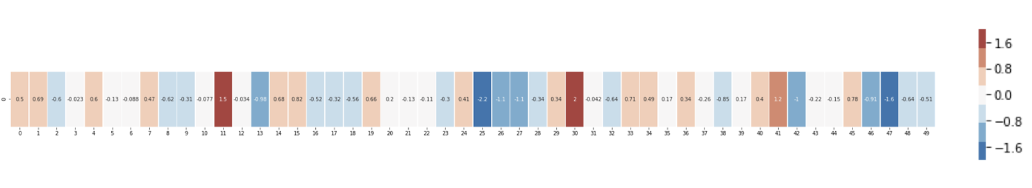
Words Represented as Numerical Vectors

Slide 5
Word Embeddings
There has been a huge amount of research into word embeddings or “vector space representations”, particularly as input for deep learning NLP models.
Literally thousands of academic papers.
Typically used as a form of preprocessing for deep learning algorithms.
Allows individual words to have some “intrinsic” meaning.
Example: First ten dimensions of embedding for the word “football” in the GloVe 200 dimensional embedding space:
{-0.11, -0.34, -0.99, 0.85, 0.1, 0.74, -0.1, 0.36, 1.2, …}

Slide 6
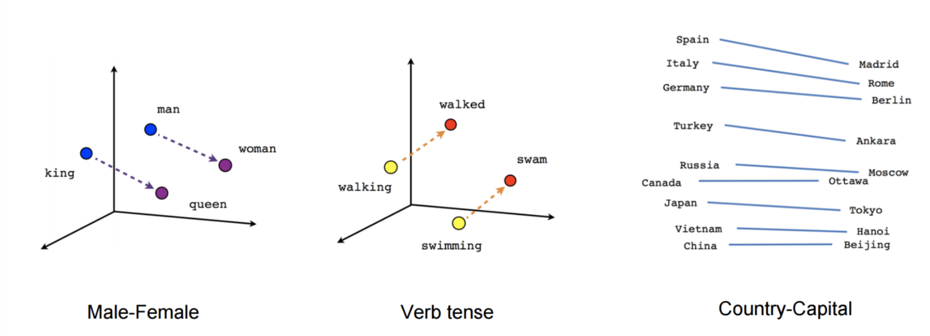
Representing Relationships Between Words
Relative position of words in vector or embedding space can tell us about relationships among words.

Slide 7
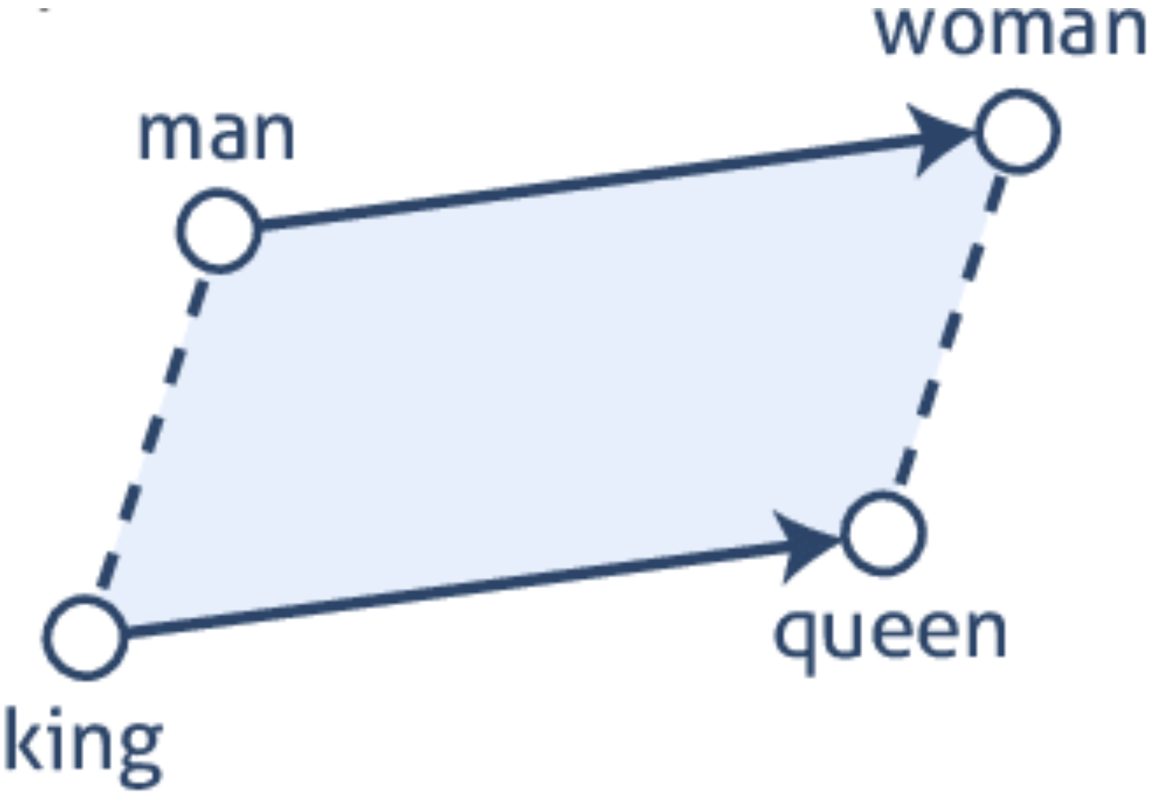
Solving Analogies

Slide 8
Representation Learning
Word embeddings are cool, and useful in a number of settings, but how do we generate them?
Answers come from field of “representation learning” where we use a machine learning model to learn the vector space representation of each word.
Common models include Google’s Word2Vec, Stanford’s GloVe, Fasttext, etc. We will focus on the Word2Vec model in this lecture.
Goal of all of these models is to take a very large collection of documents as input and return a k-dimensional output numerical representation of each of the words in that corpus.
To have good performance, these models rely on absolutely enormous training corpora.
Typically have a neural network model architecture.

Slide 9
Word2Vec
Basic intuition: train a binary classifier to predict words that will show up close to each other. Use the weights the classifier learns for this task as the vector space embedding for each word.
Magic advantage here is we do not need any human labeled training data -- we can just use the co-occurrence of terms near each other in real documents as our “training data”.
Relatively fast to train – but is dependent on having lots of data.
We will cover: "skip-gram with negative sampling" (SGNS)

Slide 10
Classification Tasks
Prediction task is to predict what word will show up at a given target position (t) in a document given some context words.
Two different ways to conceptualize the problem.
Continuous Bag of Words (CBOW)
Use words that occur near the target word to predict the target word.
Skip-Grams (SG)
Use the target word to predict the context words around that target.
Tends to provide better performance in practice.

Slide 11
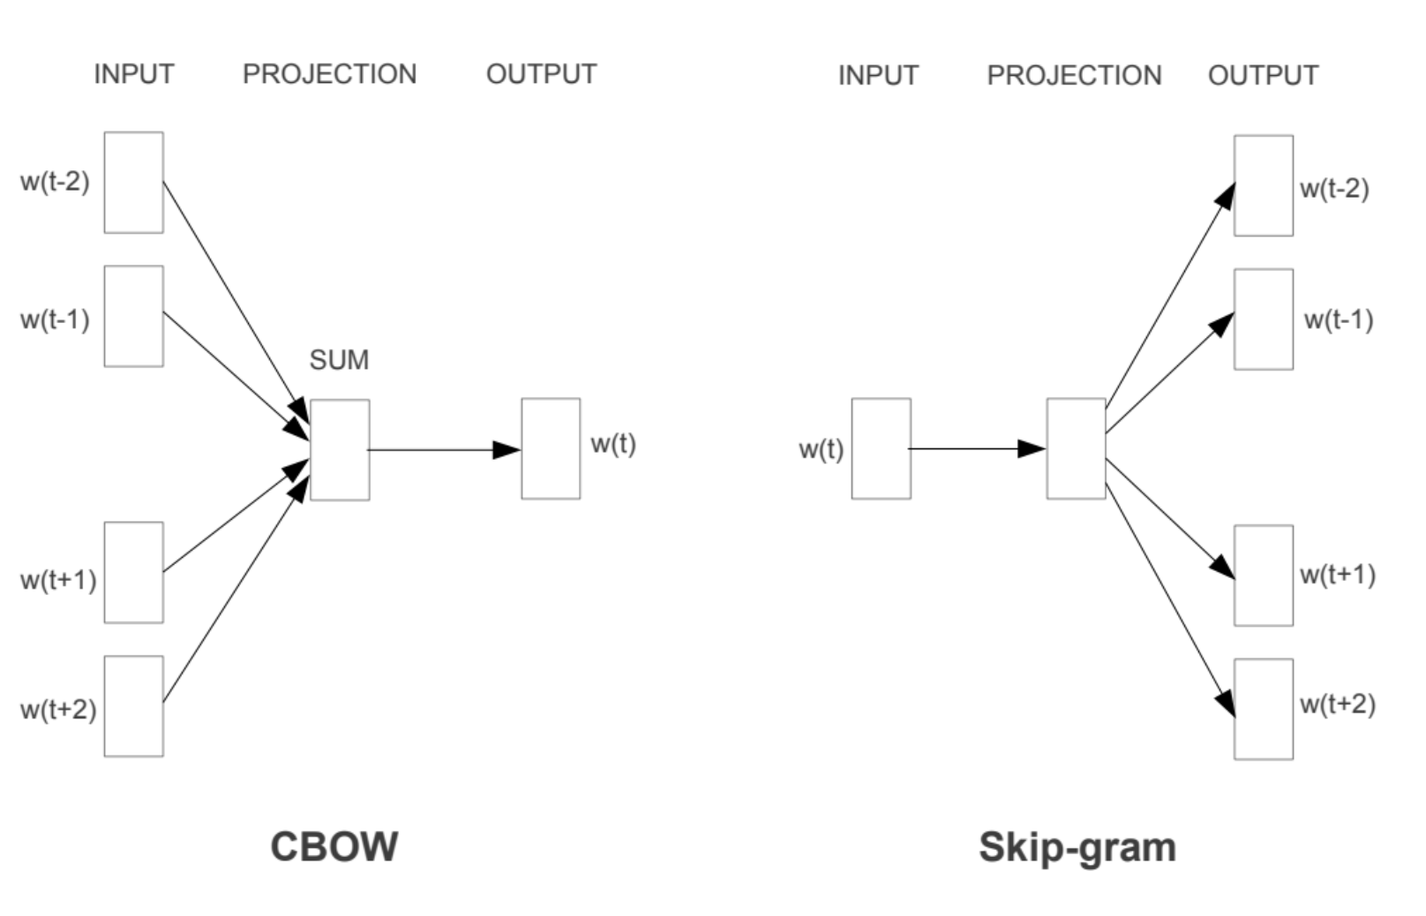
Classification Tasks

Slide 12
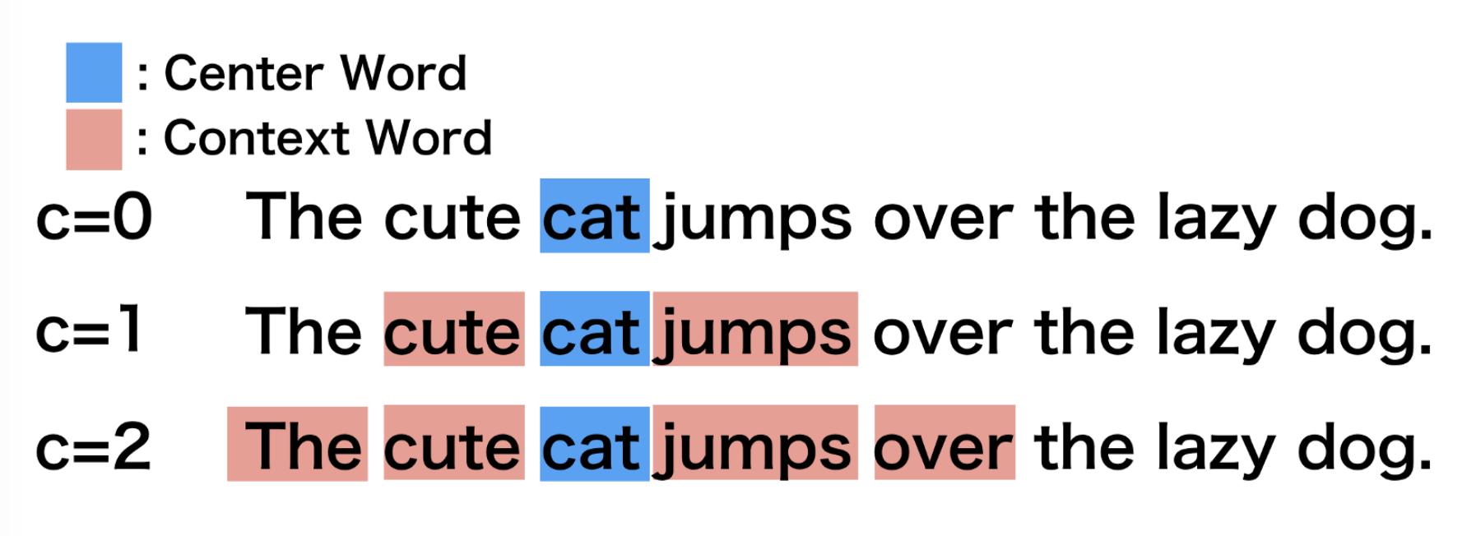
Context Window

Slide 13
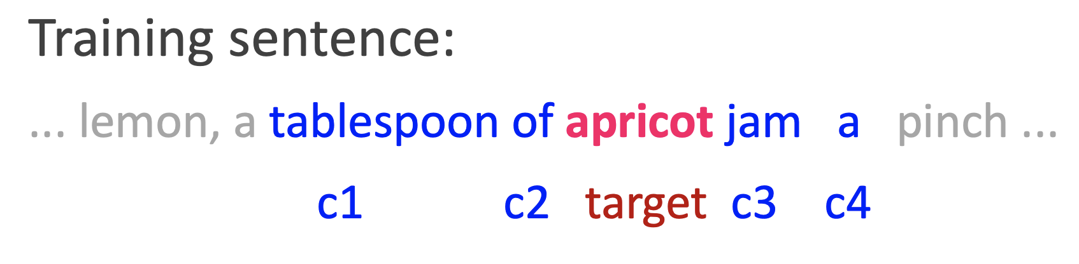
Skip-gram training data
Typically break up the input training data into sentences.
Words that are close to other words but separated by sentence boundary can have little to no similarity.
Paragraphs with different topics, etc.

Slide 14
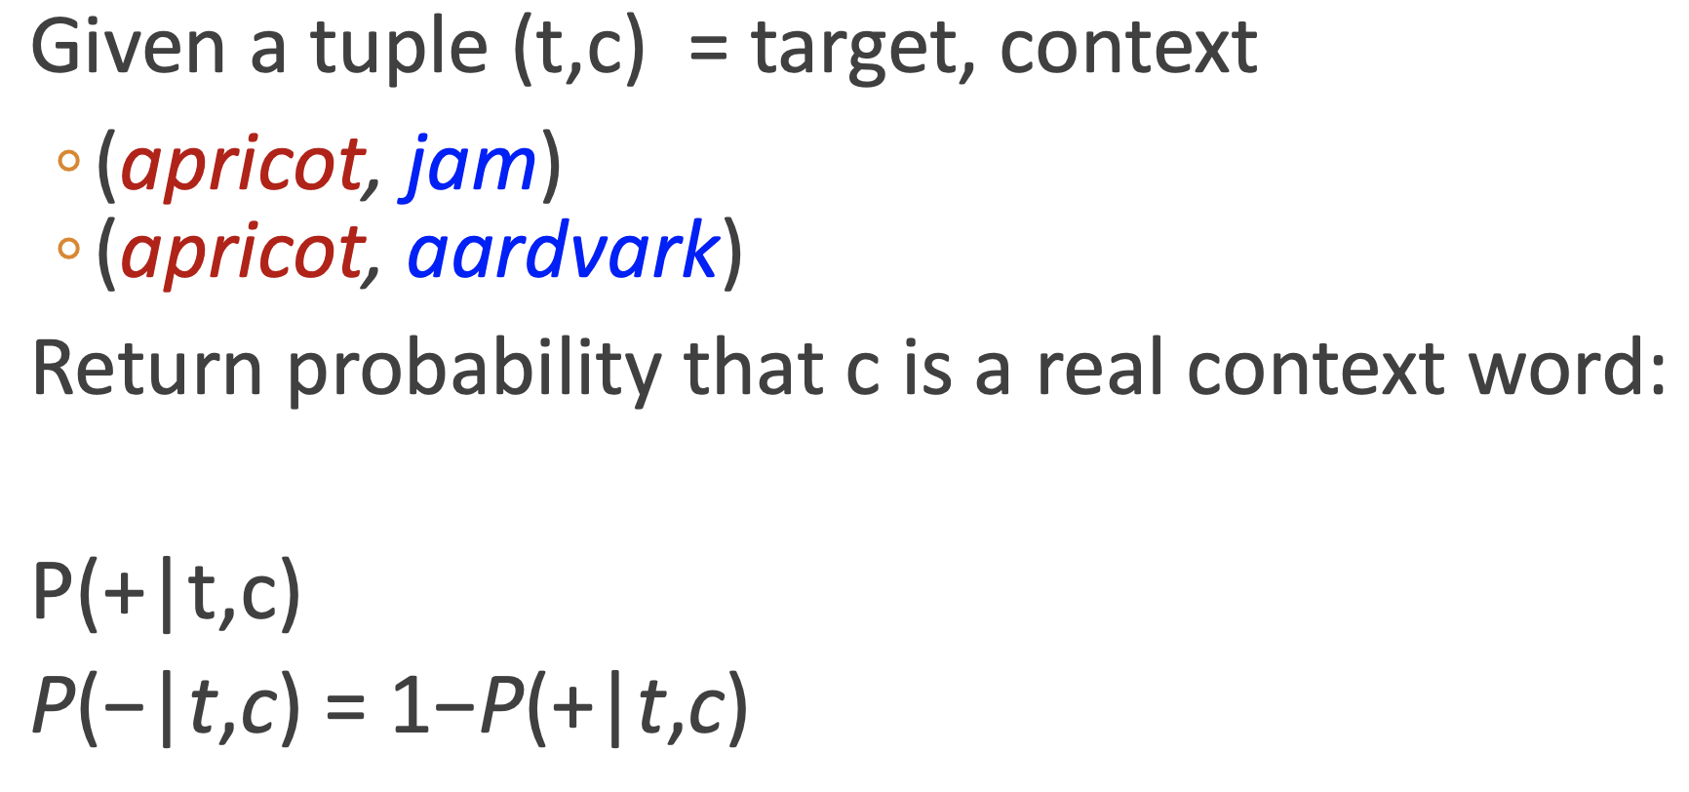
Goal with Skip-gram Approach

Slide 15
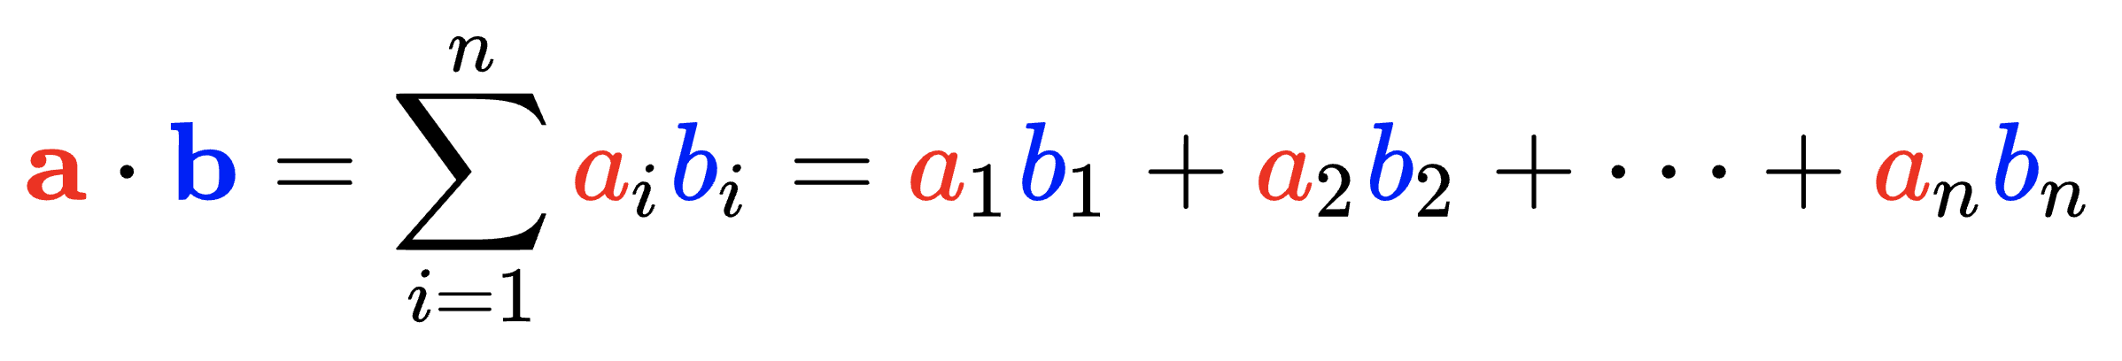
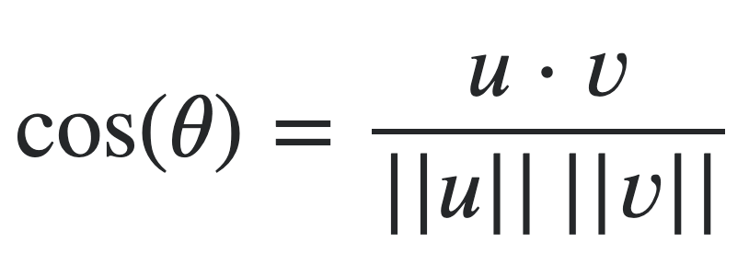
The Dot Product
Consider two vectors:
Then to dot product of those two vectors is:
Can serve as a measure of similarity between two vectors as it is inherently related to cosine similarity.

Slide 16
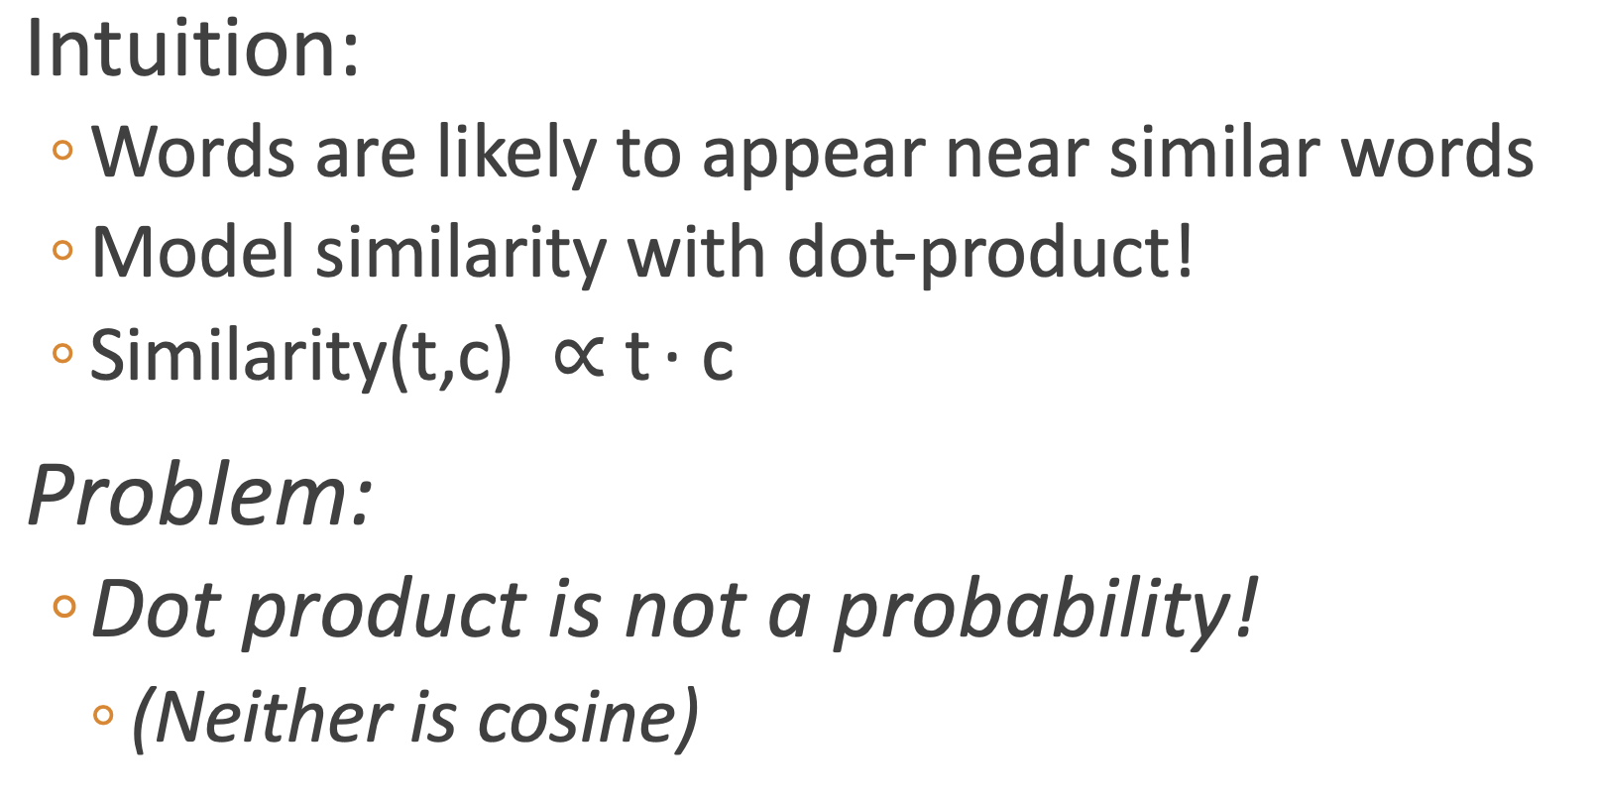
How to Generate These Probabilities?

Slide 17
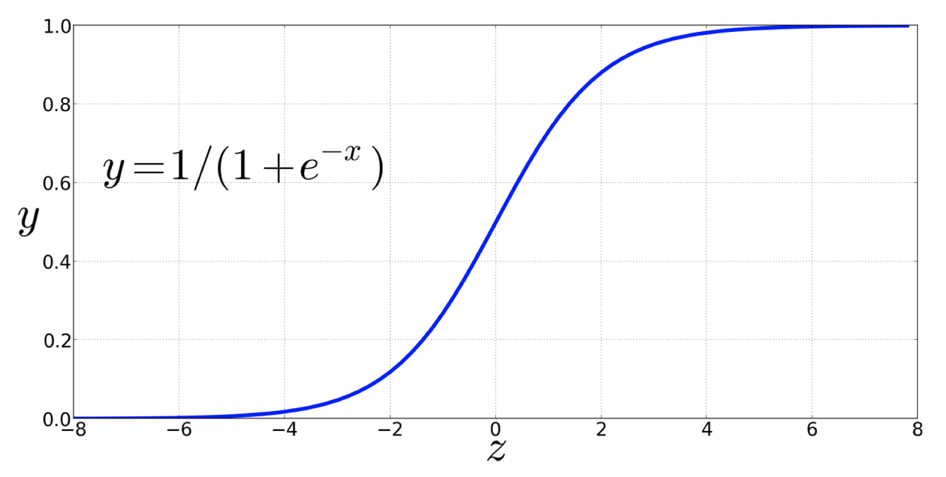
Logistic Sigmoid Function Gives us Probabilities

Slide 18
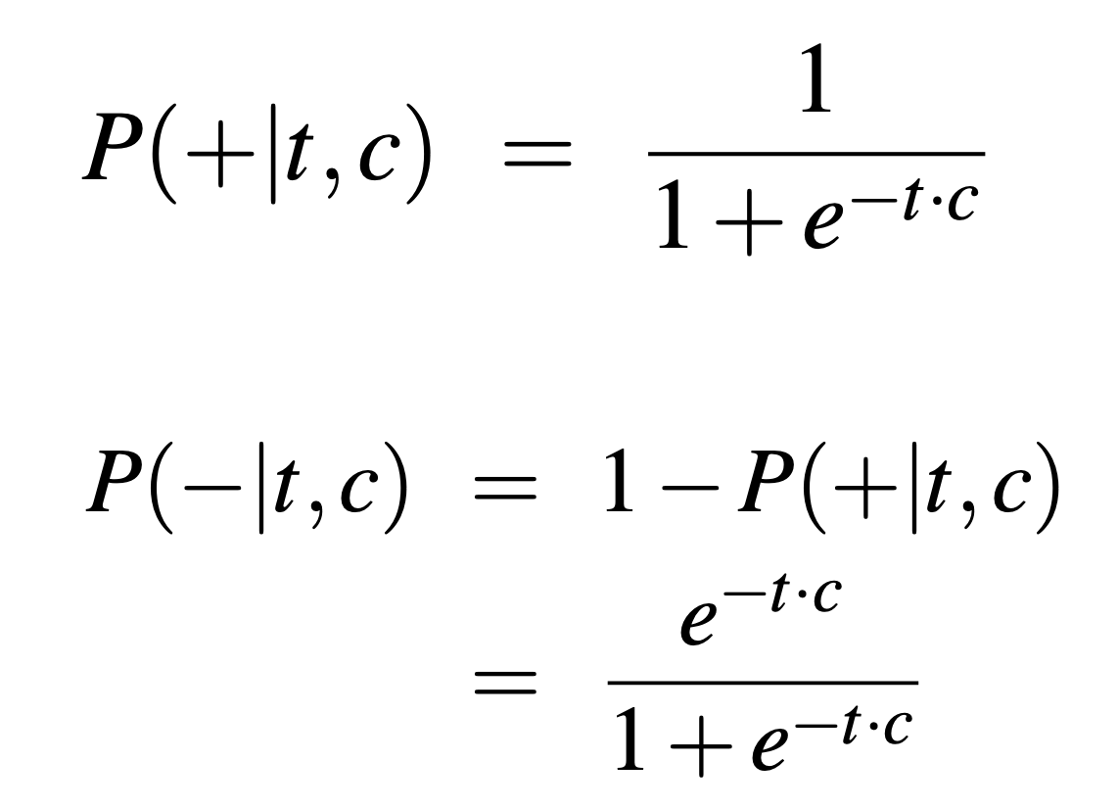
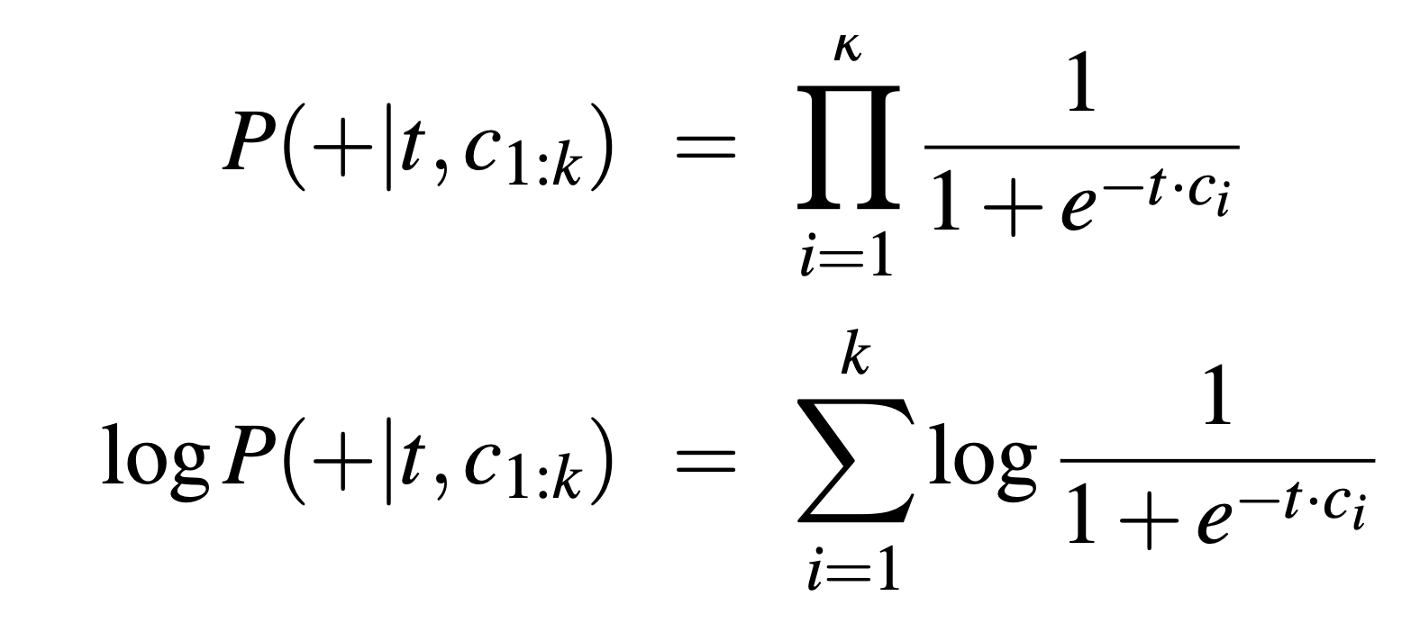
Probabilities
Can generate probabilities of a context word being a real context word for a given target by transforming dot product of context word co-occurring with target word in given context window across all times target word appears.
Can roll up this probability over all words in context window.

Slide 19
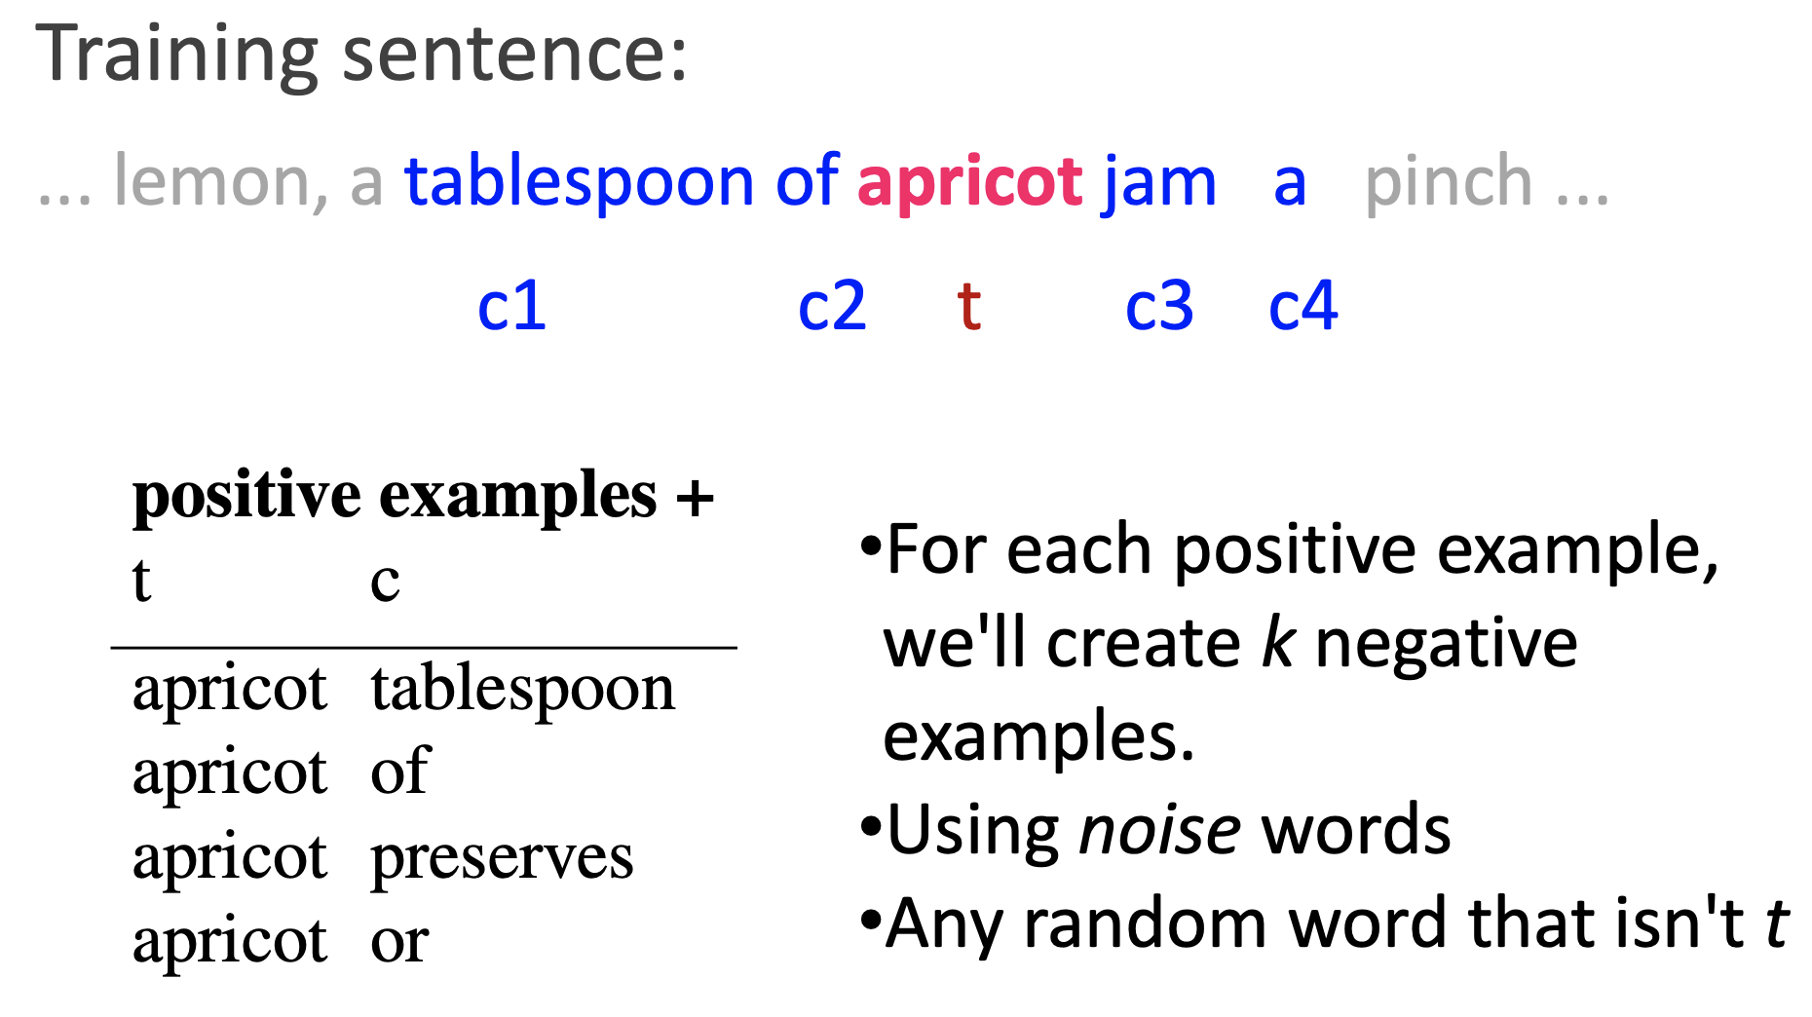
Generating Positive and Negative Examples

Slide 20
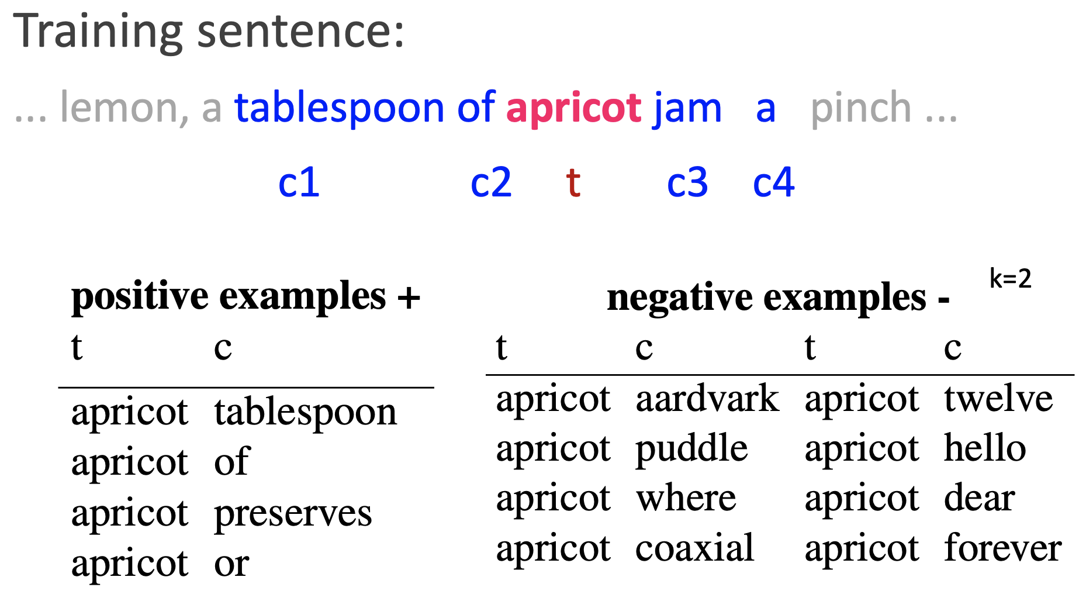
Generating Positive and Negative Examples

Slide 21
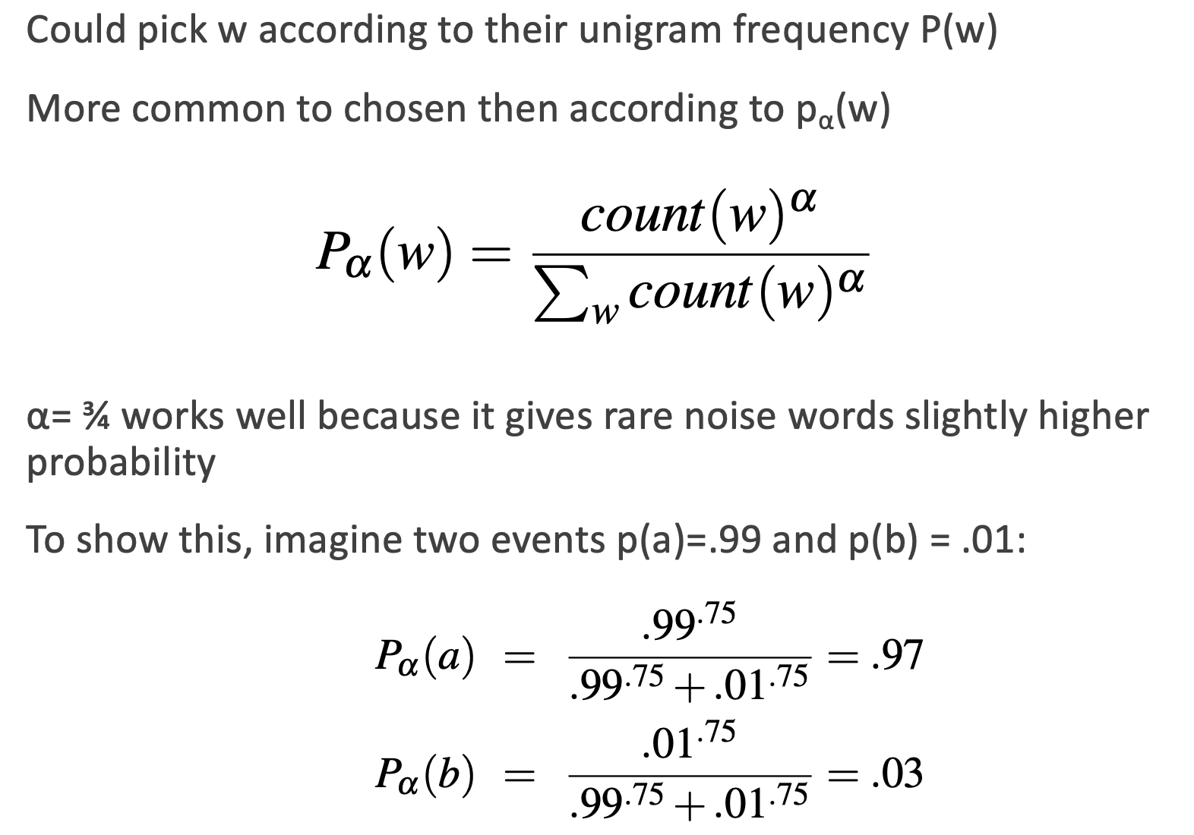
Picking Negative Examples

Slide 22
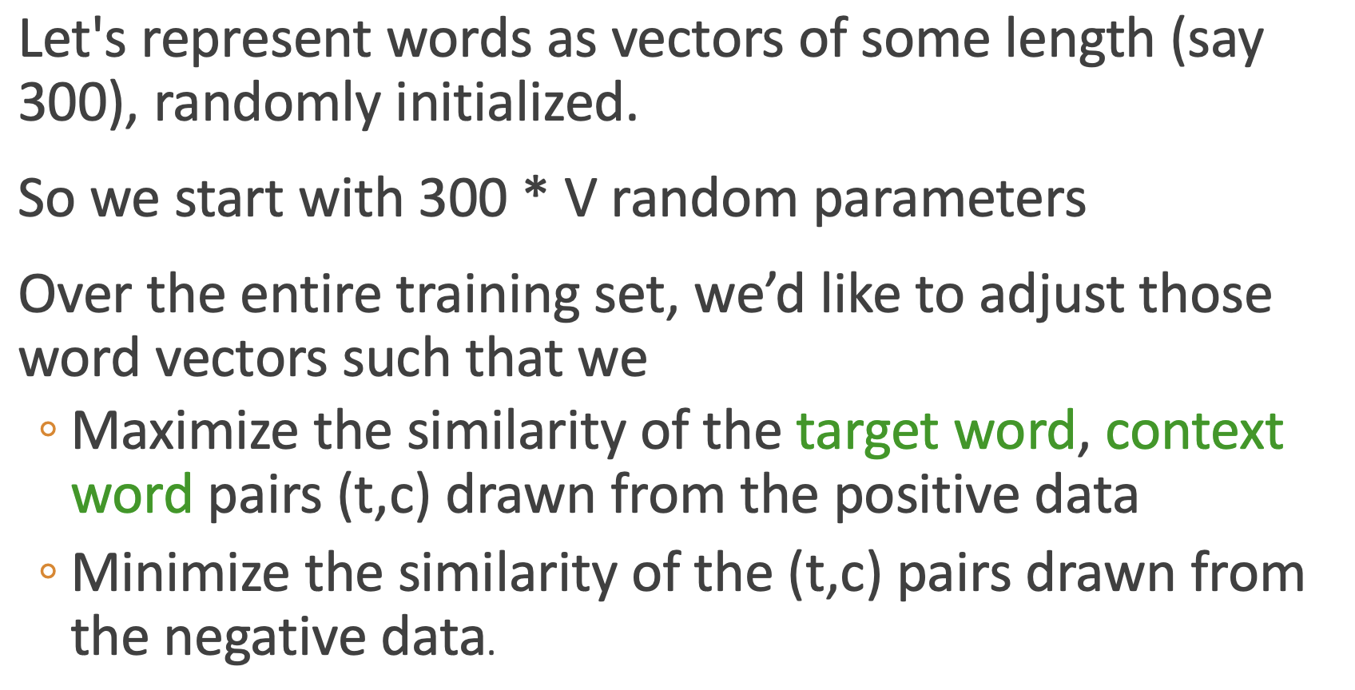
Model Training Objective

Slide 23
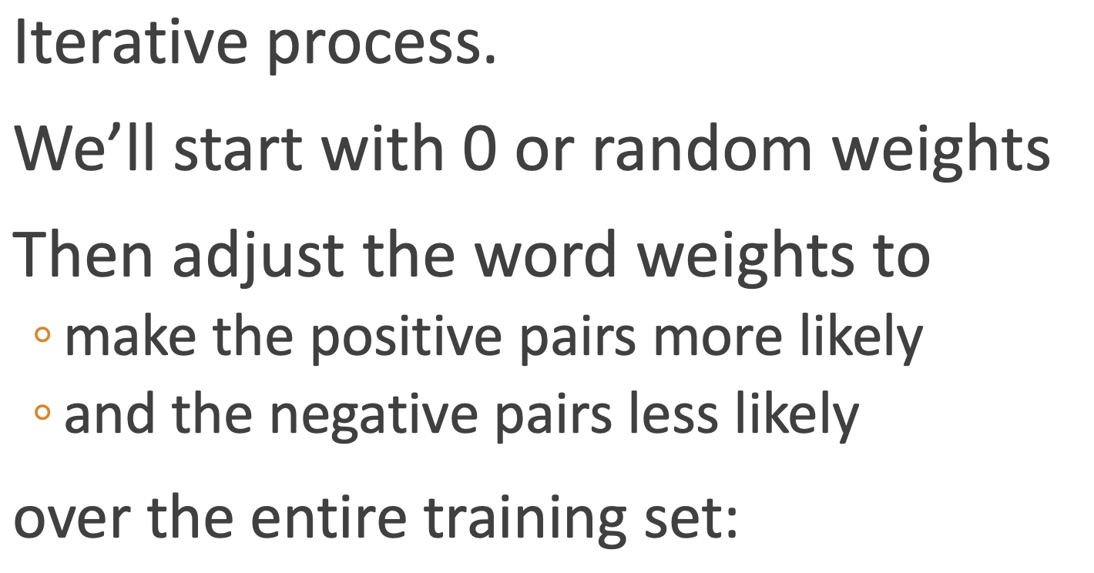
Model Training Process

Slide 24
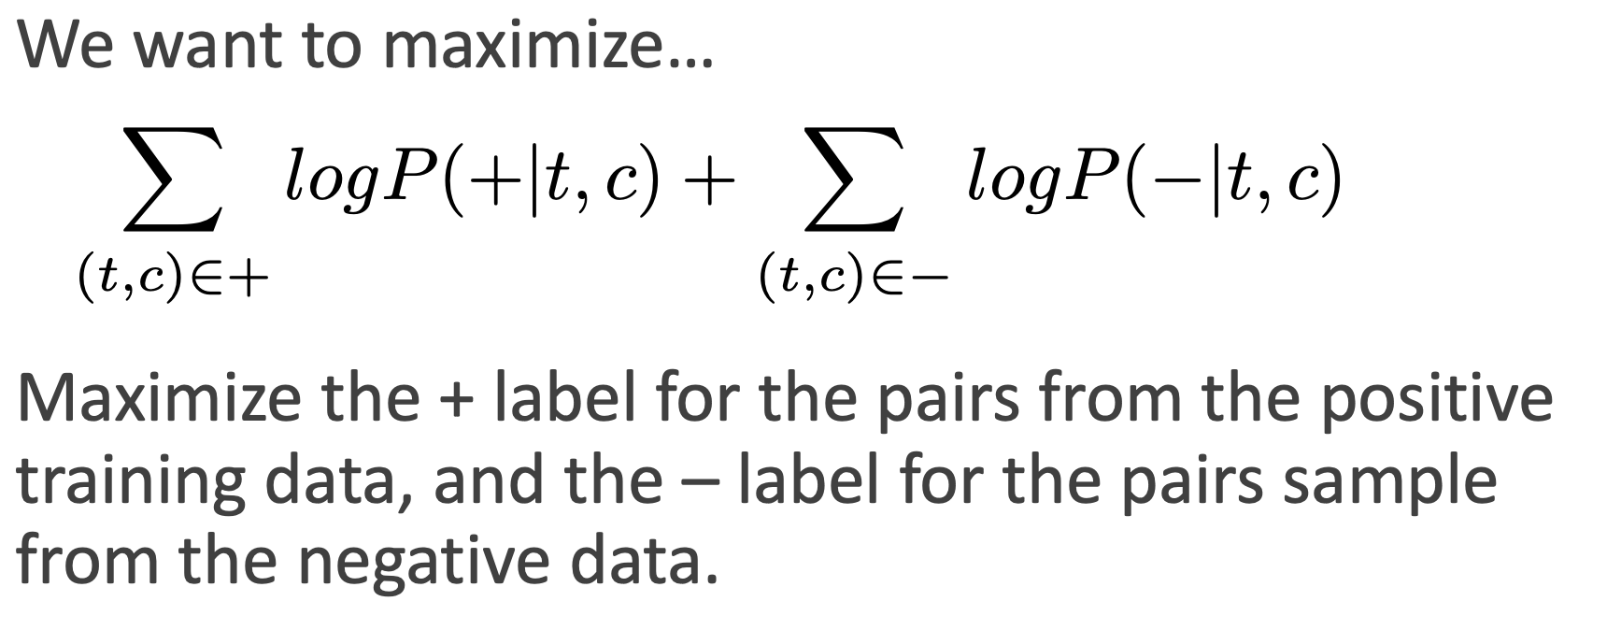
Objective Function

Slide 25
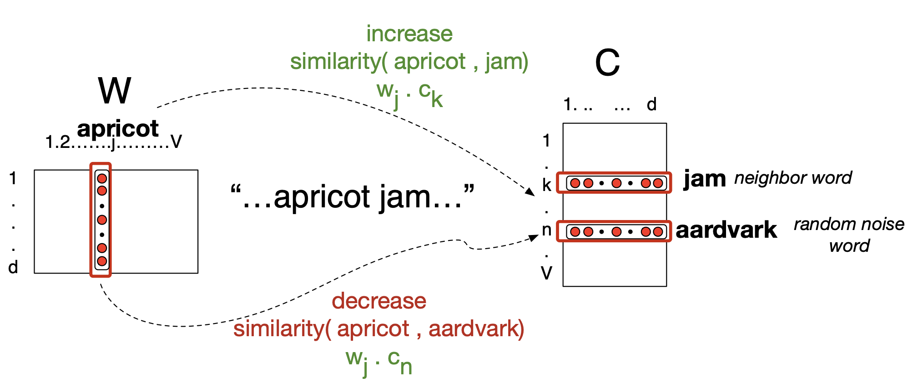
Example of Iterative Adjustment

Slide 26
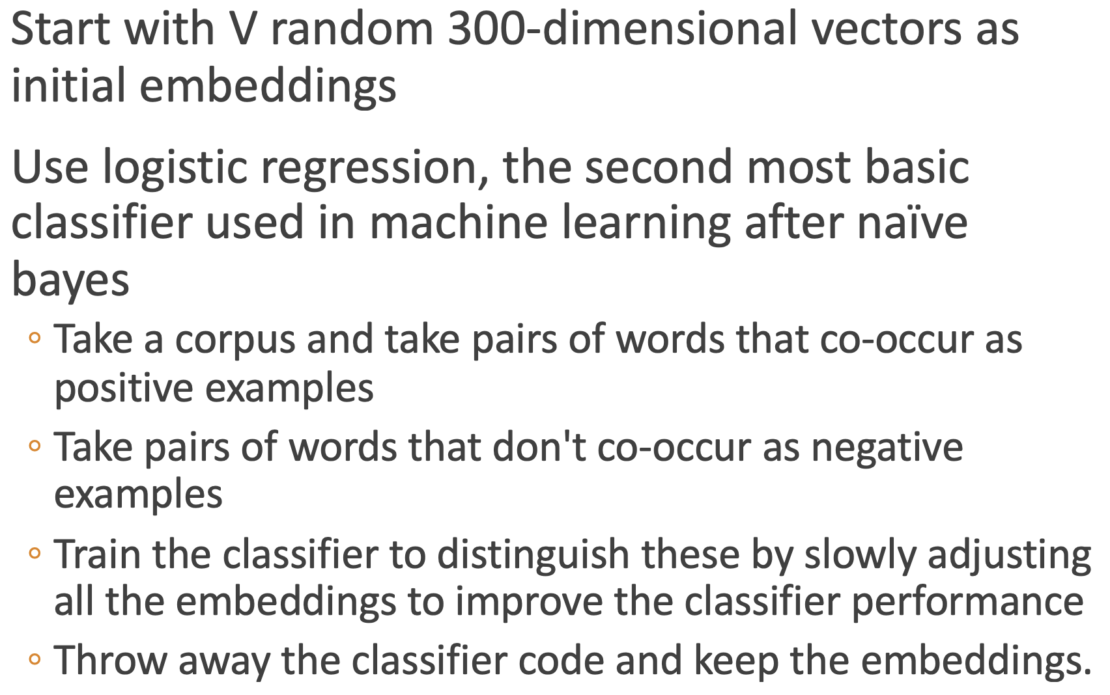
Overview of Word2Vec Training

Slide 27
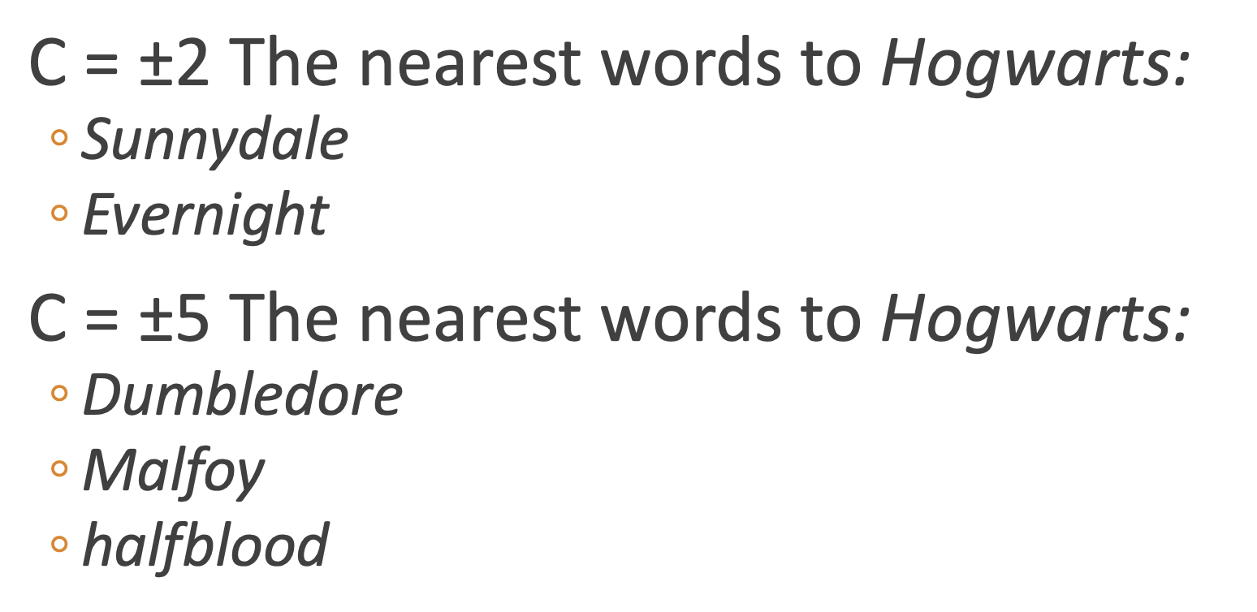
Context Window Effects Results
Changing size of context window for training will lead to model identifying different terms as being most similar.

Slide 28
Using Word Embeddings
Now that we have numbers represented as embedding vectors, we can apply lots of nice mathematical concepts:
Similarity between words as distance in the embedding space.
Relationships between words as a ray (a direction in the embedding space + a distance)
Geometry of concept relations: e.g. analogies.
Calibrated embeddings as a way to translate text, concepts.
Find different words that share the same meaning when used in different contexts (e.g. legislators and CEOs use different terms to talk about the same regulations).
Look at changes in term associations over time, by covariates, to uncover changing word use, linguistic bias, etc.
Requires you to train your own embedding model.

Slide 29
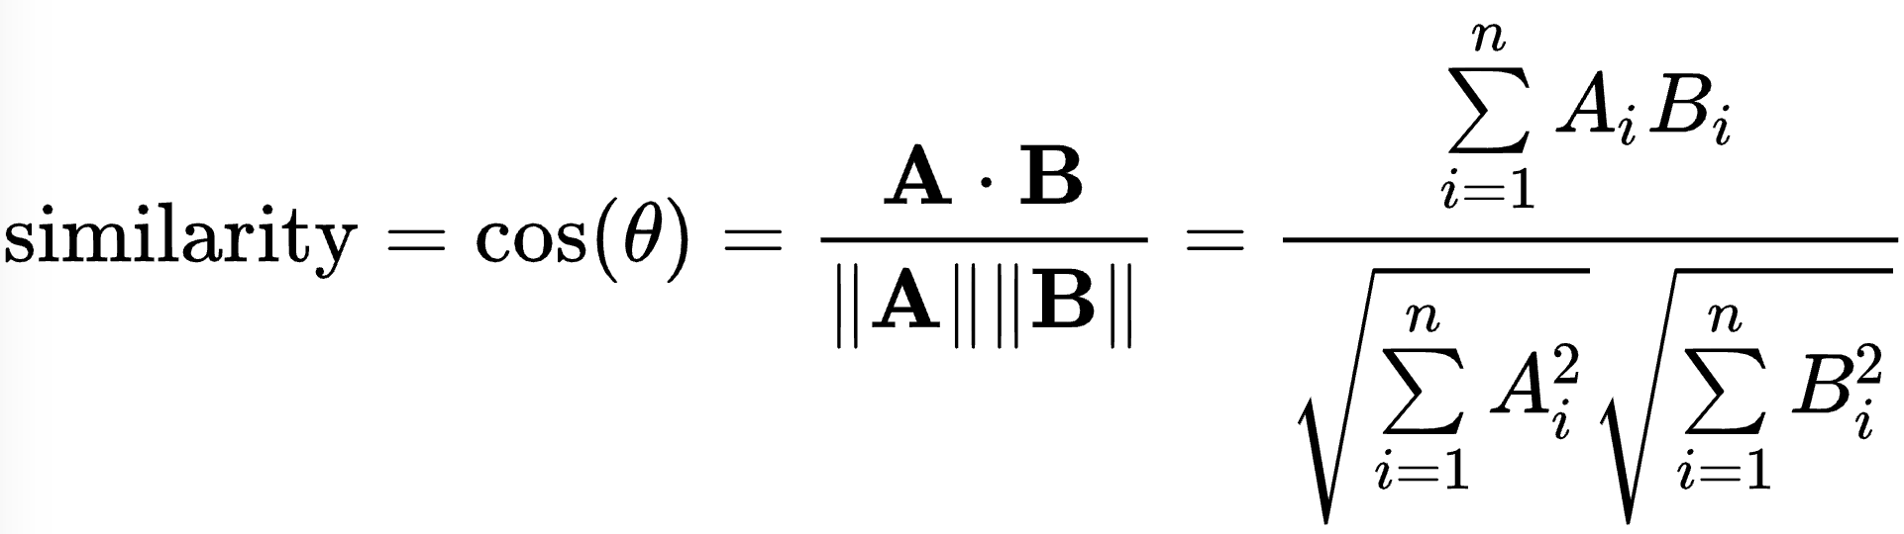
Cosine Similarity
Input: Let A and B be term vectors as with Euclidean Distance.
Formula:
For text, takes on a value between zero (totally unrelated) to one (meaning exactly terms appear in same proportion).
Interpreted as angle between term vectors.
Normalized for document length.

Slide 30
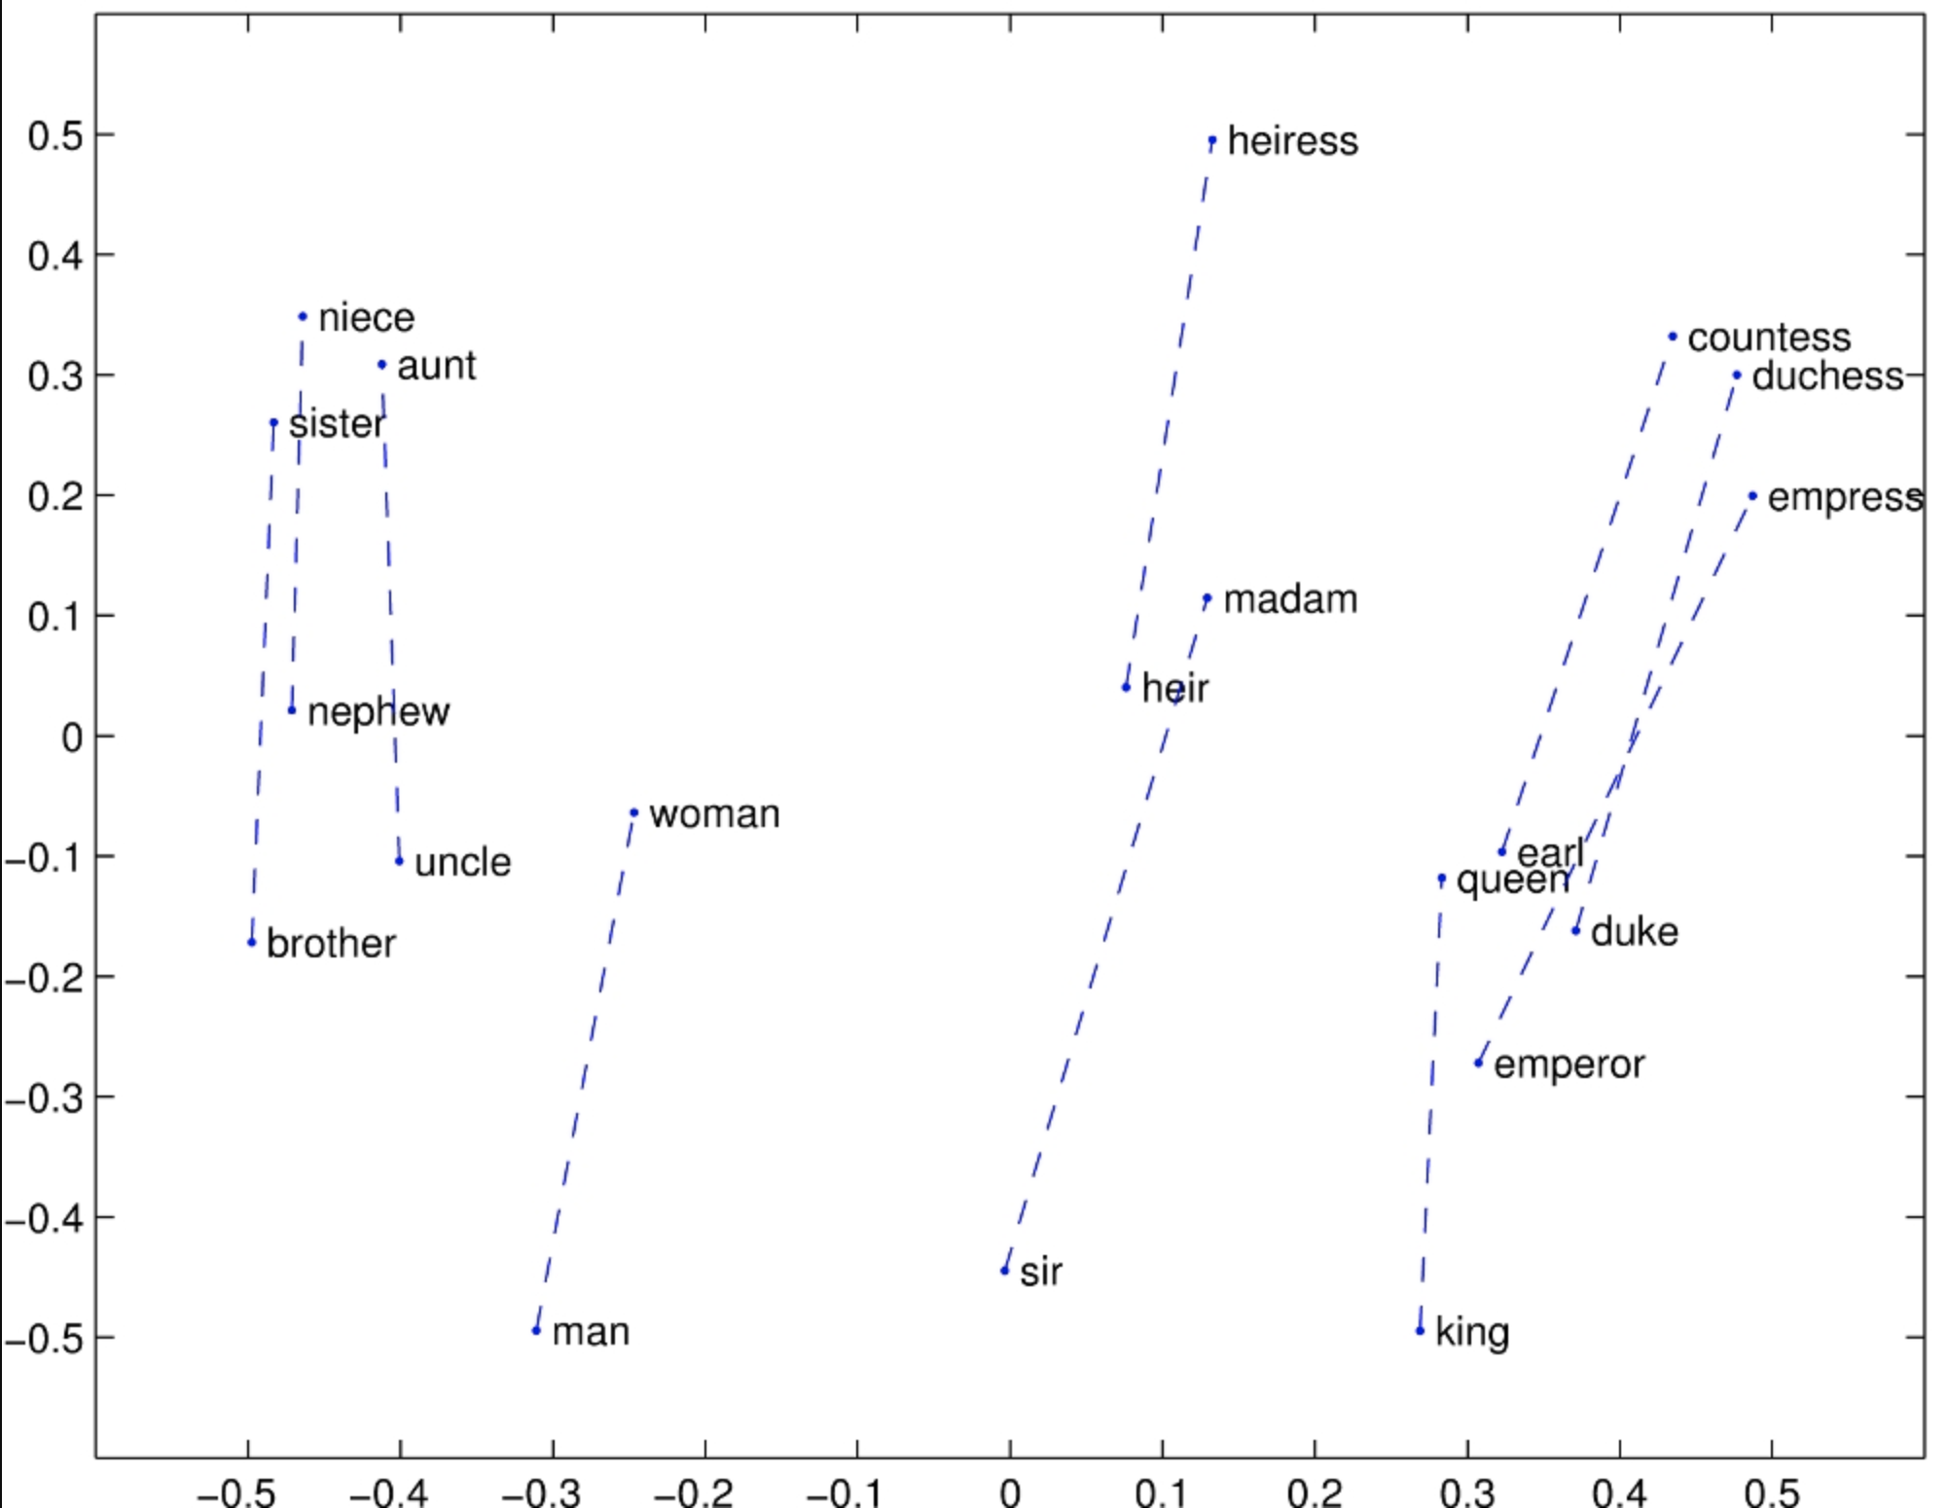
Gender Relationships

Slide 31
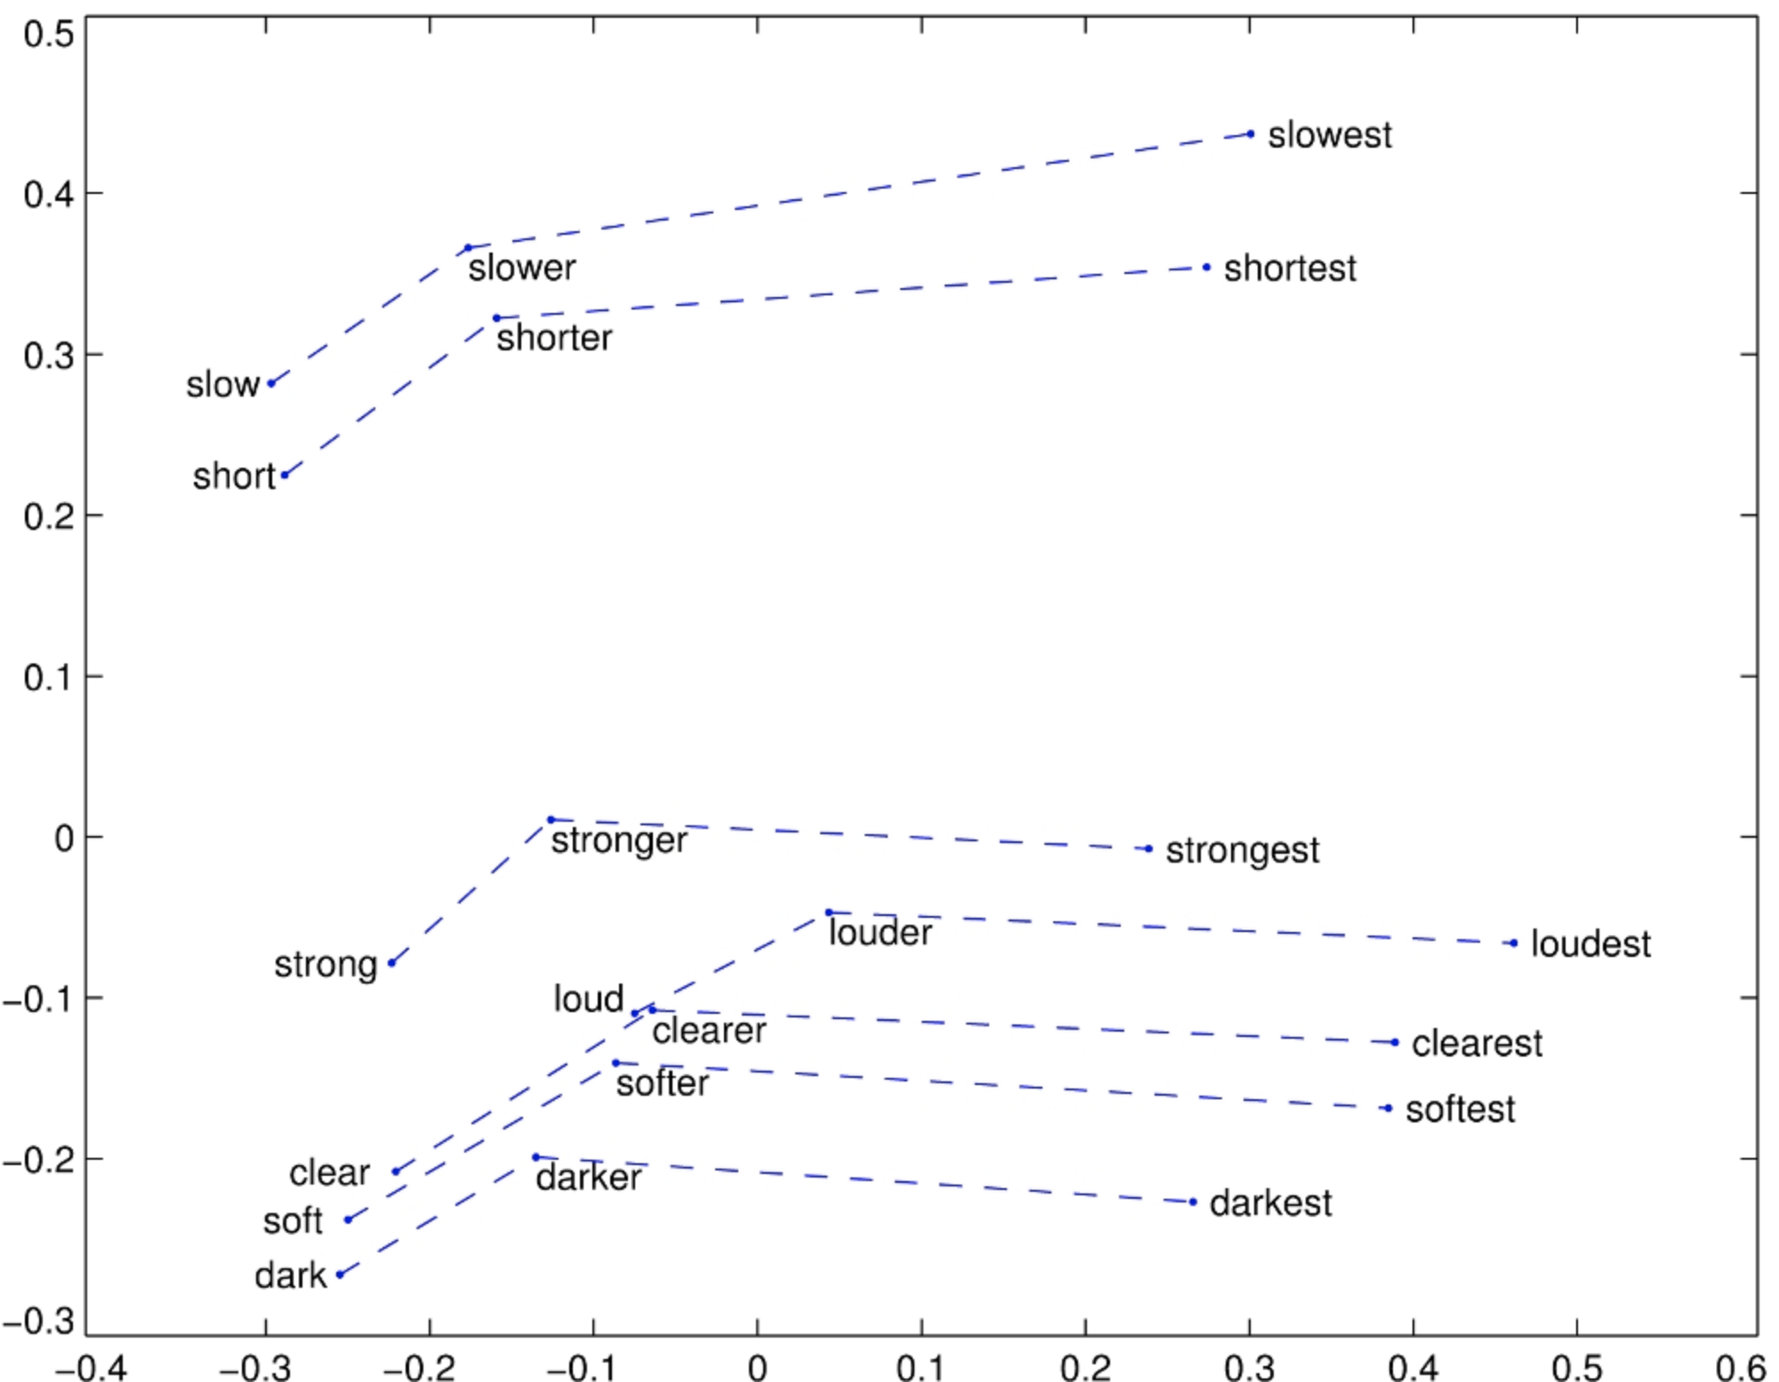
Superlative Relationships

Slide 32
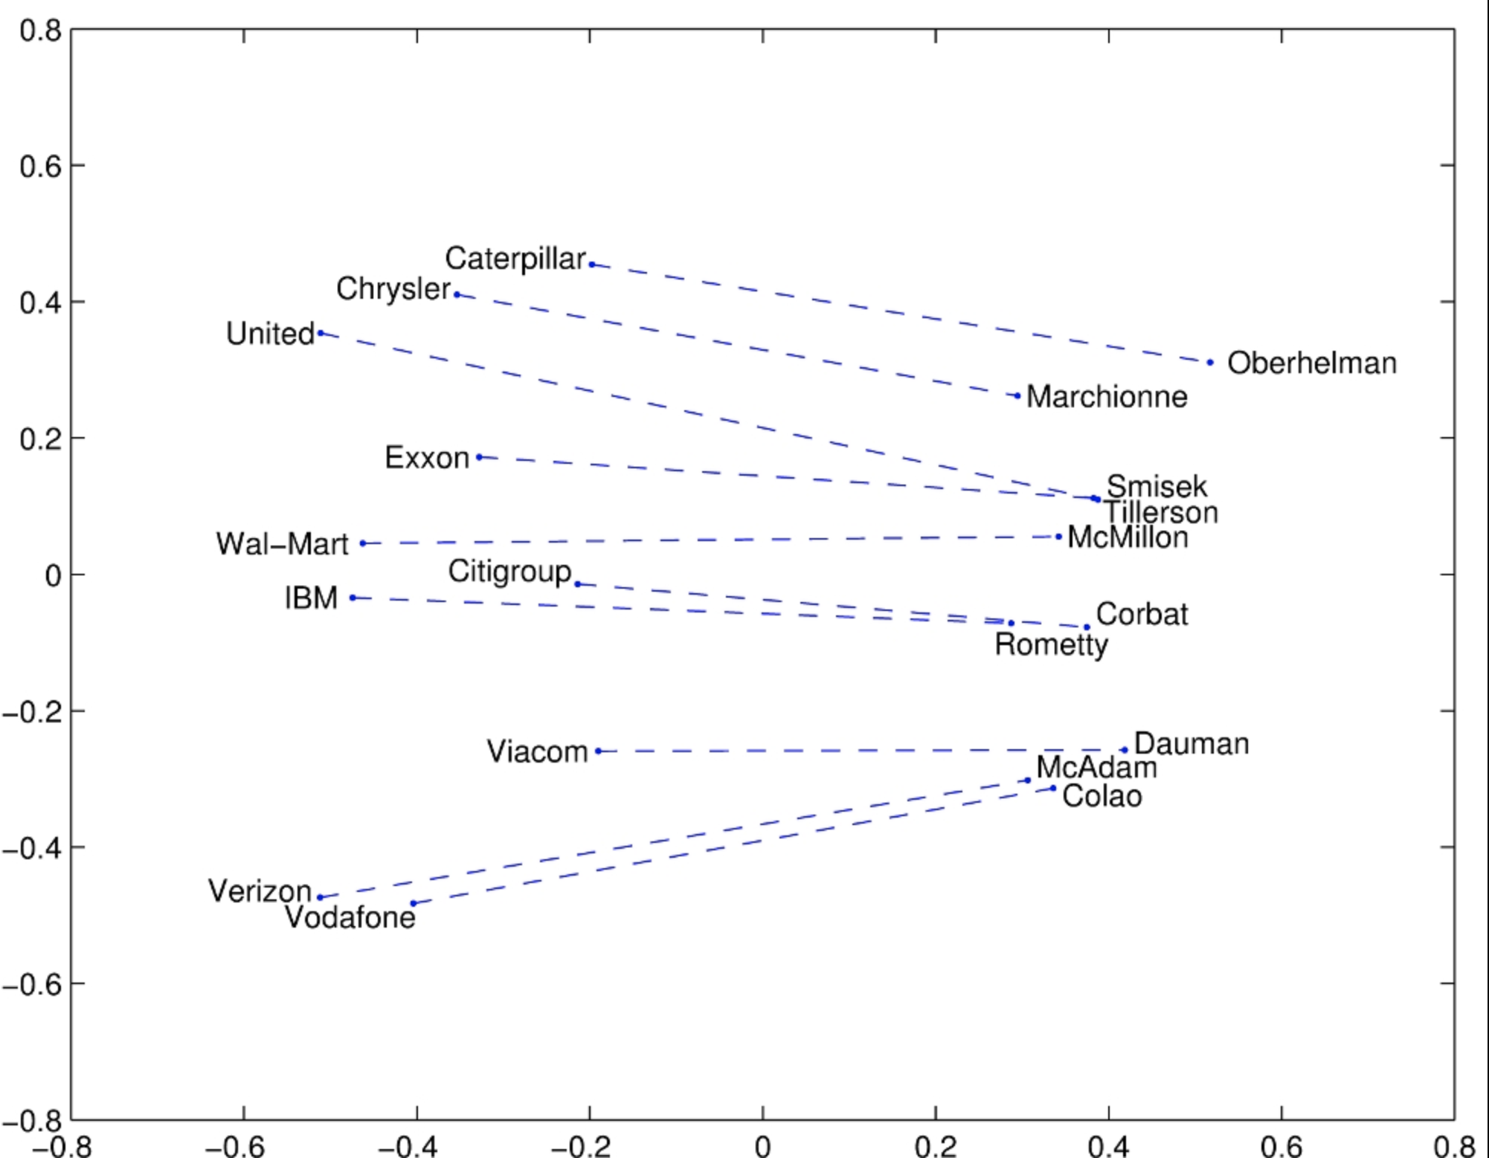
Company-CEO Relationships

Slide 33
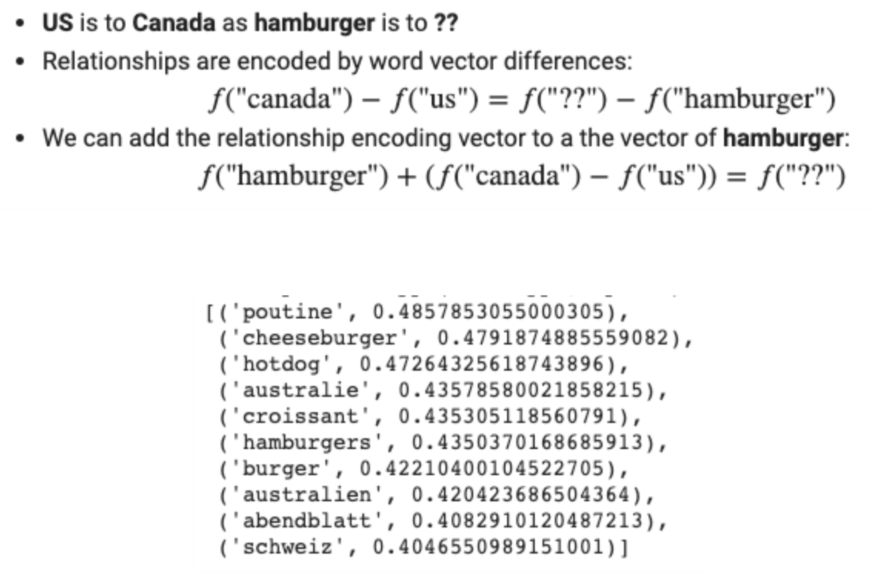
Solving Analogies

Slide 34
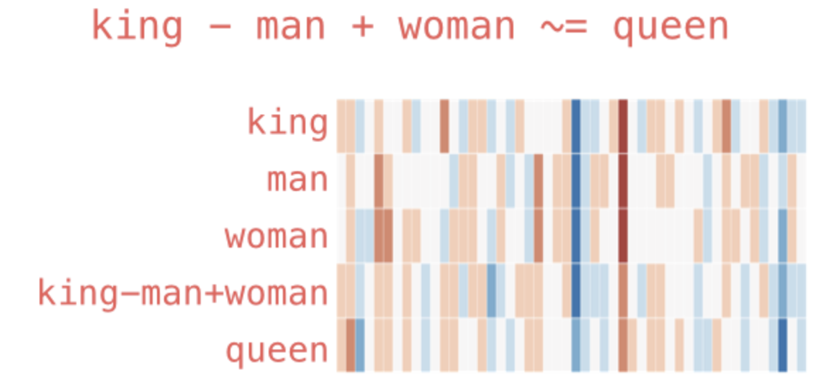
Solving Analogies

Slide 35
Social Science Applications
This is the tricky part…
Train embeddings on different corpora to estimate differences in word association.
Gender and racial bias.
Over time.
Changes in language use.
Document similarity, Author similarity/scaling.
Preprocessing augmentation to combine two different sources of text.

Slide 36
My Take
Vector space representations of words will become increasingly important over the next few decades with the continued rise of deep learning methods.
Right now, only a limited set of social science applications can really benefit from using them.
In many cases, using pre-trained embeddings is the way to go. Need huge amounts of data and processing power to get excellent general purpose results.
You need a lot more training to know what you are doing when fitting word embedding models. Good opportunity for collaboration.

